Slide 1
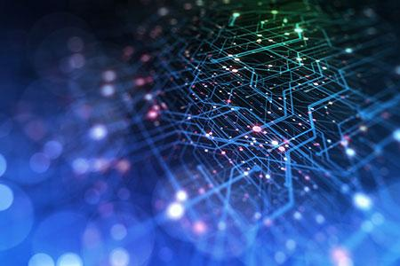
Data Team Report Out
Notes:
Thanks for the introduction
Thanks to the organizers for the invitation to give a keynote
Of course, I would like also to thank all the collaborators and students, postdocs and researchers who collaborated with me.
Don’t count, there are more than 450 ;-)
You know it already; it is extremely hard to succeed alone in research. So, I took the easy way: I collaborated with many talented researchers.
I would like to thank all of them for sharing some of their time and for all the discussions we had.

Slide 2
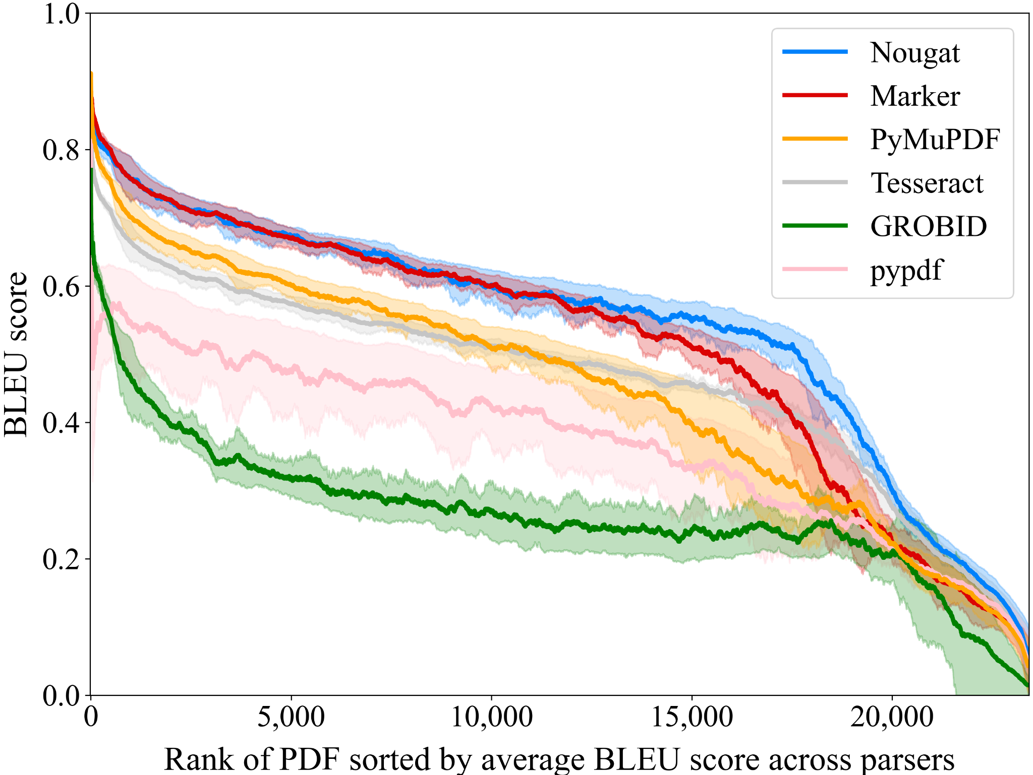
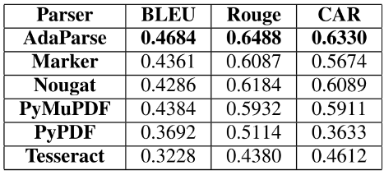
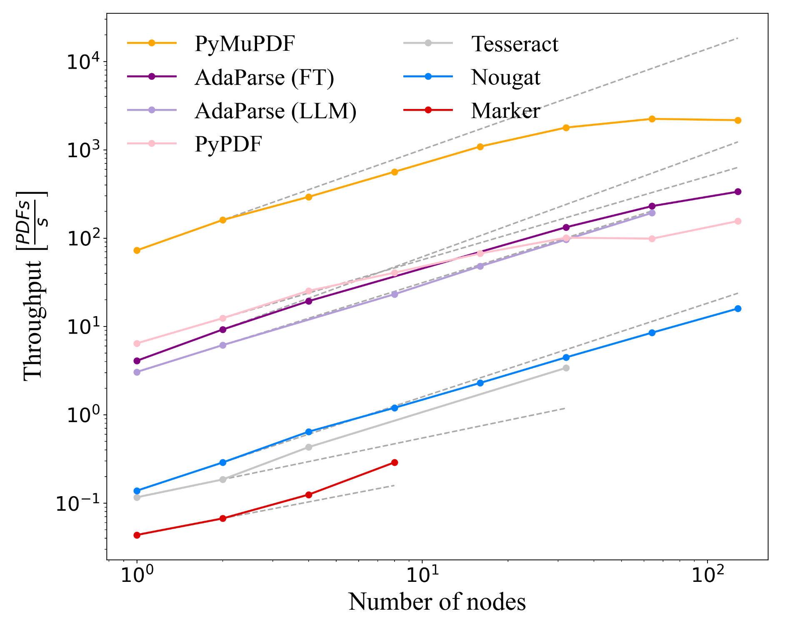
Applying AdaParse to New Collections
Progress this week:
The team worked on evaluating scalability and quality of parsing
Identified new datasets to parse
Many groups were excited to try AdaParse to parse scientific and technical documents
234,350 Wiley journal articles on materials science/chemistry
“Old” PDF papers on natural science before 2000
BIS is interested in deploying AdaParse with Argo

Slide 3
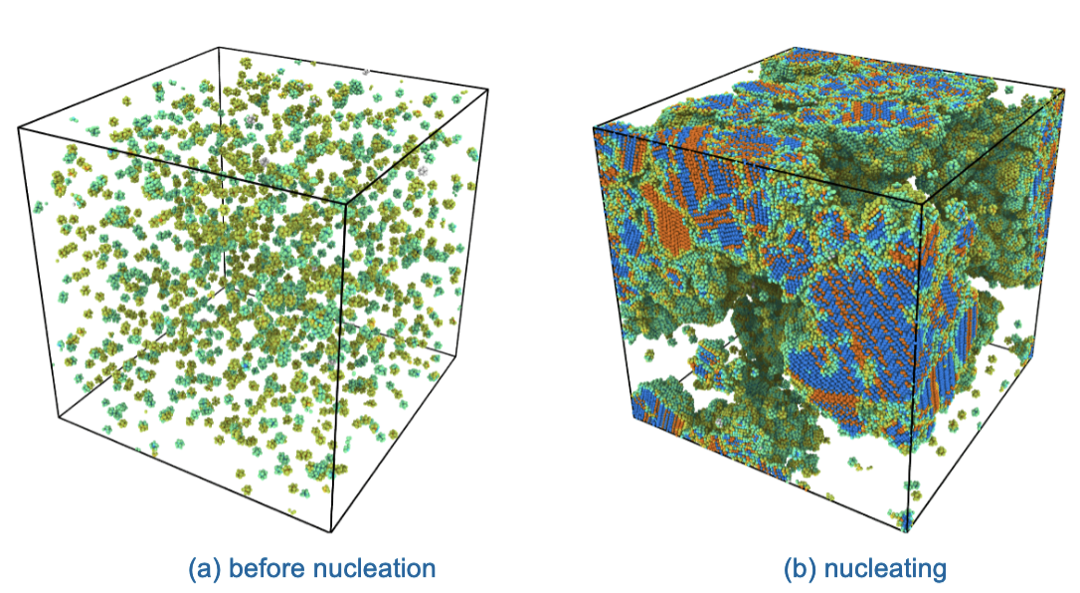
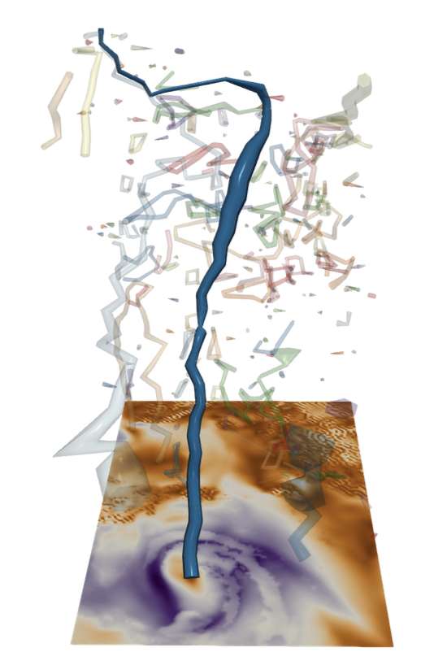
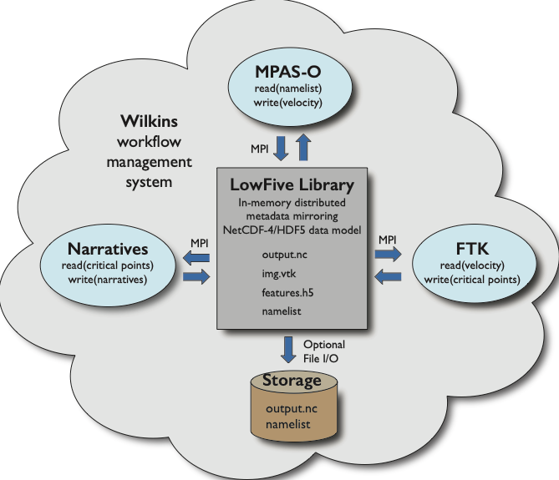
Narratives for Unstructured Data
Particle data: molecular dynamics
Ensemble of LAMMPS simulations, stochastic nucleation process
In situ crystal structure feature extraction and tracking
Narratives about crystal number, distribution, growth rate
Unstructured mesh data: climate modeling
MPAS-Ocean simulation
In situ critical point feature extraction and tracking
Narratives about critical point number, trajectory length, duration
HPC workflow: executing simulations and feature extraction / tracking in situ
Generate data on demand
Analyze in situ
Automate narrative generation
Nucleation of water molecules in molecular dynamics simulation
In situ HPC workflow coupling MPAS-O with feature tracking
Tracking critical points in ocean simulation

Slide 4

Generation of Synthetic of Parallel Code
LASSI: Recent work demo - LLM-based capability to translate sci codes between frameworks (e.g., C++ CUDA to C++ OpenMP - used HeCBench)
Discussed scaling challenges
Consider additional benchmarks to use for ground truth, similar to MS Phi-2 / 3 models with “Alpaca seeds”.
Extend existing pipeline prompting to refactor code for other tasks, e.g.,:
Various workflow tool use, job placement
Checkpoint restart
Power management/energy efficiency (in progress)
...

Slide 5
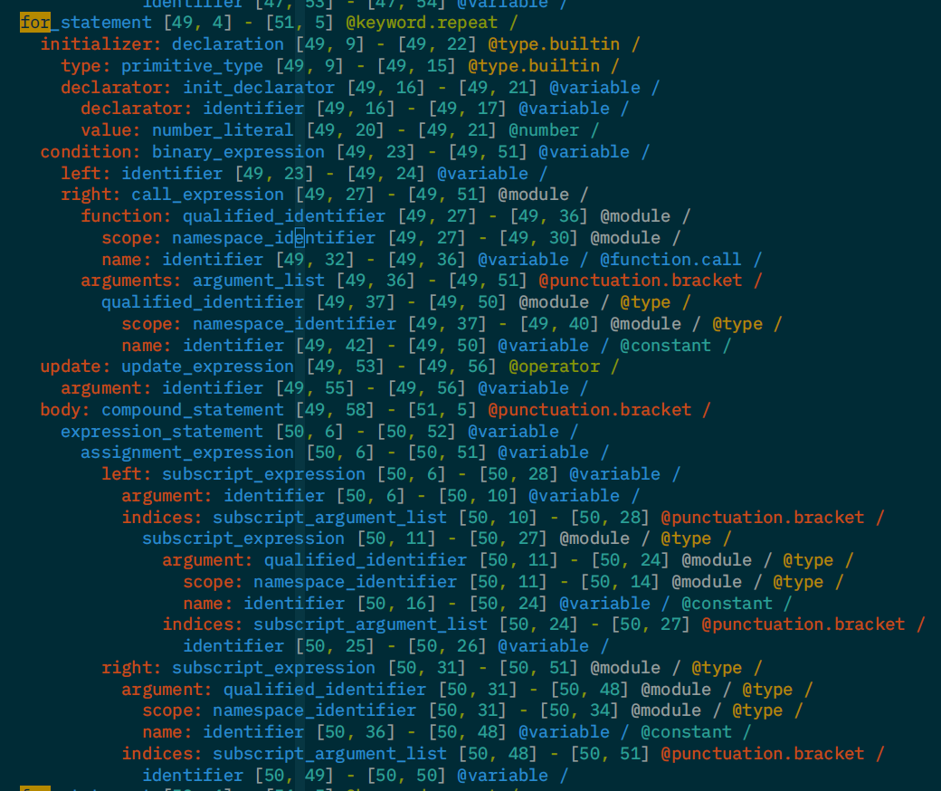
Deduplication of Code and Multi-modal data
Progress this week:
Discussed patterns for deduplicating large volumes of synthetically generated code
Auto gen of code translations - use as validation and threshold tuning tool for dedup
Syntax trees for code structure / vector embeddings for code semantics
Notes:
https://www.comp.nus.edu.sg/~atung/publication/treematch.pdf https://leodemoura.github.io/files/ICSM98.pdf

Slide 6
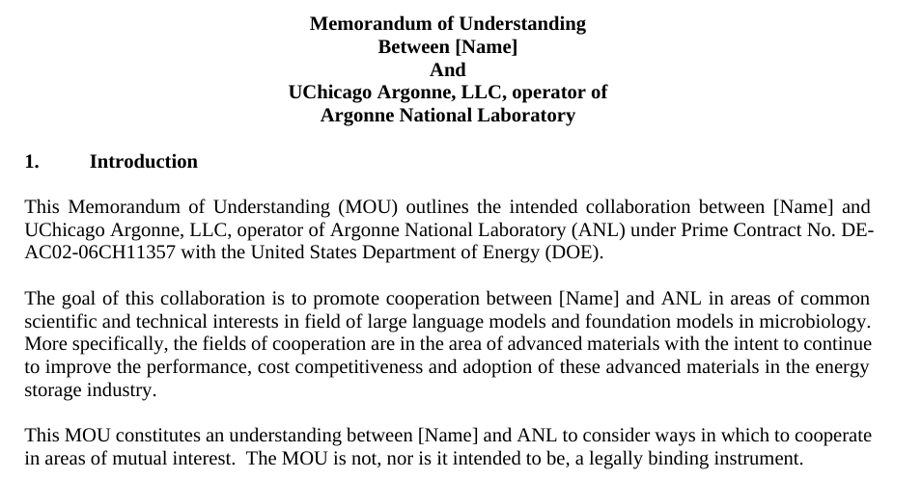
Sharing Agreements and Collaborations on Datasets
Progress this week:
Enumerated data sets of scientific text useful for training
Shared template agreement used with publishers
Argonne will work with BSC and OpenAIRE to collaborate on identifying datasets and sharing template agreements with publishers

Slide 7
Why Multi-modal RAG
What to build:
DiskANN for HPC
Workflow integration to scale primitives to distributed
Query optimizer
We want to link data to text and visa versa:
select ai_distinct image from images ai_join papers using invert(paper->sensor) where paper ai_contains $material_common_name
select paper from papers ai_join image (paper->sensor) where image ai_contains $image CROSSATTN $prompt
This is foundational for RAG enhanced templates
We need high performance to quickly ensembles of experiments

